Slide 1
RUNGTA COLLEGE OF DENTAL SCIENCES & RESEARCH
TITLE OF THE TOPIC-
MANAGEMENT OF DEEP BITE
DEPARTMENT OF ORTHODONTICS AND DENTOFACIAL ORTHOPAEDICS

Slide 2
Specific learning Objectives
CORE AREAS | DOMAIN | CATEGORY
INTRODUCTION | AFFECTIVE | DESIRE TO KNOW
ZONES OF DEEP BITE | COGNITIVE | NICE TO KNOW
CLASSIFICATION | COGNITIVE | MUST KNOW
ETIOLOGY & DIAGNOSIS | COGNITIVE | NICE TO KNOW
CLINICAL FEATURES | COGNITIVE | MUST KNOW
TREATMENT | PSYCHOMOTOR | MUST KNOW

Slide 3
Contents
Introduction
Zones of deep bite
Classification
Etiology and diagnosis
Clinical features
Treatment
Conclusion

Slide 4
Must to know
Normal overjet and overbite
Need to know
Zones of deep bite
Desire to know
Prevalence of deep bite.
Treatment
Diagnosis
Planes of malocclusion
Classification
etiology
Growth patterns.

Slide 5
INTRODUCTION
Deep overbite presents an orthodontist with challenge in any of its many forms.
Diagnosis ,treatment planning and appropriate mechanics form an backbone of successful orthodontic treatment.

Slide 6
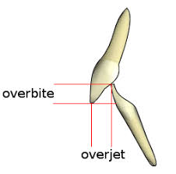
NORMAL OVERBITE
In normal overbite the upper incisors slightly overlap the lower incisors and is usually expressed in mm.

Slide 7
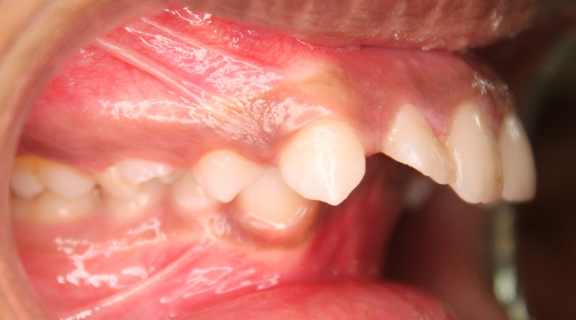
DEEP OVERBITE / DEEP BITE
GRABER
“A condition of excessive overbite, where the
vertical measurement between the maxillary
and mandibular incisal margins excessive
when the mandible is brought into
habitual or centic occlusion.”
STRANG
“The overlapping of the upper anterior
teeth over the lowers in the vertical plane.“
Dr RAVINDRA NANDA
“Amount & percentage of vertical overlap of lower incisors by upper incisors.”

Slide 9
ZONES OF DEEP BITE
5% to 25% is normal (yellow),
25% to 40% is increased overbite (orange),
40% and more is excessive (deep) overbite (red).

Slide 10
Terminologies in relation to deep bite
CLOSED BITE
COVER BITE
The vertical measurement between the maxillary and mandibular incisal margins is excessive when the mandible brought into habitual or centric occlusion, which is resulting from loss of posterior teeth.
The vertical measurement between the maxillary and mandibular incisal margins is excessive when the mandible brought into habitual or centric occlusion, which is resulting from loss of anterior teeth.
Notes:
Merge to termonolgies

Slide 11
CLASSIFICATION
According to its origin
Dentoalveolar deep bite (simple)
Skeletal deep bite (complex)
According to functional classification (Hotz and Muhlemann (1952)
True deep bite
Pseudo deep bite
According to dentition involved
Primary dentition deep bite
Mixed dentition dee[p bite
Permanent dentition deep bite

Slide 12
CLASSIFICATION
Depending on the extent of deep bite
Incomplete deep bite
Complete deep bite
According to Akerly (1977)
Type I
Type II
Type III
Type IV

Slide 13
Dentoalveolar deep bite
A Simple deep bite is localized to the teeth and alveolar processes.
Occur due to over-eruption of anteriors or infraocclusion of molars.
The result may be labial version of the upper incisors and impingement of the lowers into the palatal mucosa.
Loss of permanent teeth - a lingual collapse of maxillary or mandibular anterior teeth.
The mandibular dentition, may manifest as a deep curve of spee or a reverse curve of spee in the maxillary dentition.
Graber TM, Rakosi T, Petrovic G. Dentofacial Orthopedics with functional Appliances; St. Louis, Mosby Co. 1985.

Slide 14
The deep overbite that is due to the infraocclusion of molars has the following features:
The molars are partially erupted.
The interocclusal space is large
A lateral tongue thrust or posture is present.
The distances between the maxillary and mandibular basal planes and occlusal plane are short.

Slide 15
The deep overbite caused by supraeruption of incisors has the following characteristics:
The incisal margins of the incisors extend beyond the functional occlusal plane.
2) The molars are fully erupted.
3) The curve of spee is excessive.
4) The interocclusal space is small.

Slide 16
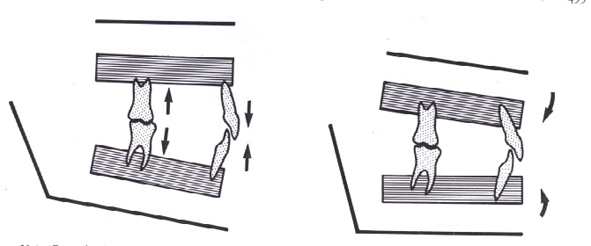
Dentoalveolar vs skeletal deep bite

Slide 17
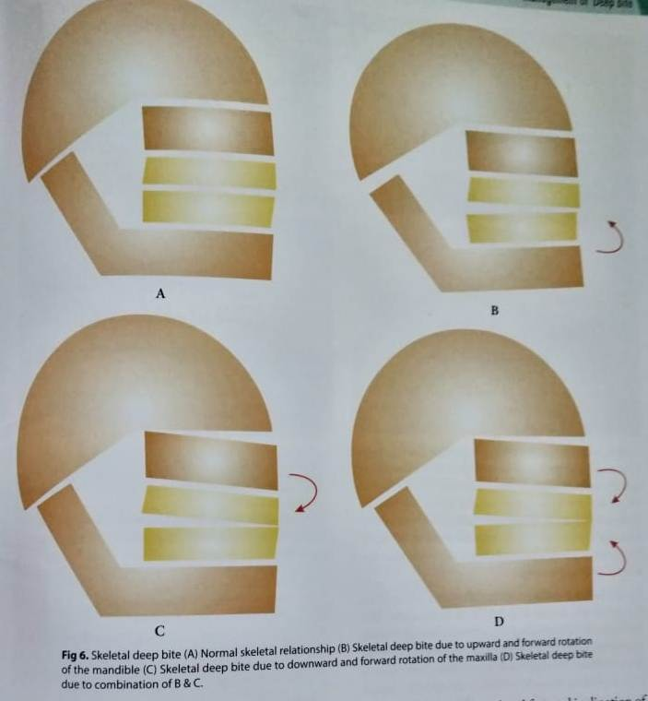
Skeletal deep bite
Normal skeletal relationship
Skeletal deep bite due to upward and forward rotation of the mandible
Skeletal deep bite due to downward and forward rotation of the maxilla
Skeletal deep bite due to combination of B & C.

Slide 18
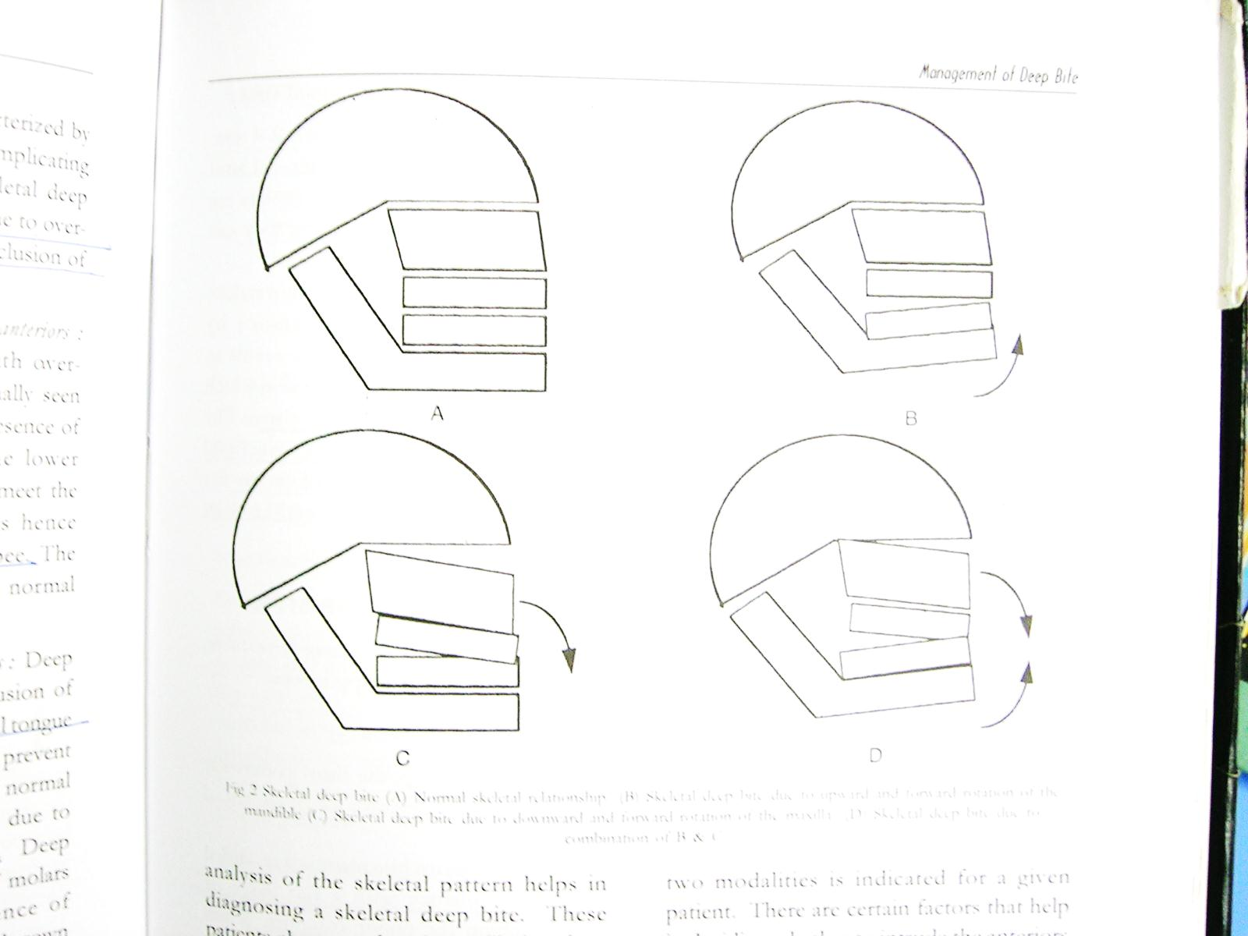
Skeletal deep bite
Due to (upward and forward) anticlockwise rotation of mandible or clockwise rotation of maxilla or due to combination of both.
The dimished anterior vertical height of the face is an important criterion for diagnosis of skeletal deep overbites.

Slide 19
Depending on the functional classification
TRUE DEEP BITE
PSEUDO DEEP BITE
This is caused by infra-occlusion of the posterior segments.
lateral tongue posture of tongue thrust - The interposition of tongue prevents the eruption of the posterior teeth. It can also occur due to premature loss of posterior teeth
This is caused by over-eruption of the anterior teeth that already has normal eruption of the posterior segment
Due to the presence of the
increased overjet, the lower
incisors to overerupt until they meet the palatal mucosa.

Slide 20
TRUE DEEP BITE
PSEUDO DEEP BITE
These patients have near flat curve of spee.
There is a large inter-occlusal clearance
Extrusive mechanics of molars possible
These patients hence exhibit an excessive curve of Spee.
The interocclusal clearance is usually normal or small as
the molars are fully erupted.
All possible intrusive mechanics on the incisor teeth with fixed appliances is usually indicated. extrusion of molars is possible only to a limited extent.

Slide 21
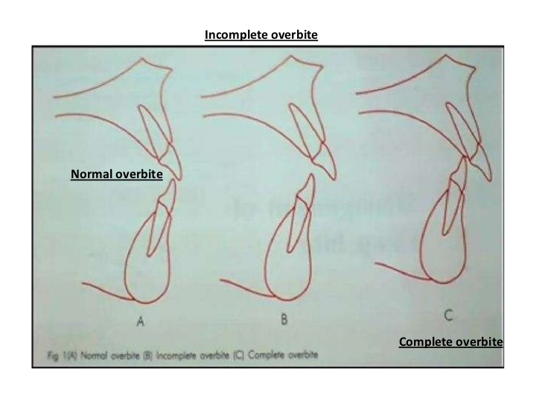
Depending on the extent of deep bite
1) Incomplete deep bite
It is an incisor relationship in which the lower incisors fail to occlude with either the upper incisors or the mucosa of the palate, when the teeth are occluded.
2) Complete deep bite
This is a relationship in which the lower incisors contact the palatal surface of the upper incisors or the palatal tissue when the teeth are in centric occlusion.

Slide 22
Stewart KL, Rudd KD, Kuebker WA. Clinical removable partial Prosthodontics 2nd Ed. IEA Inc. publishers
Akerly (1977) has classified deep bite into four basic types
Type I - Mandibular incisors extrudes and impinges into the palate.
Type II - The mandibular incisors impinge into the gingival sulcus of the maxillary incisors.
Type III - Both maxillary and mandibular incisors incline lingually with impingement of the gingival tissues of each other.
Type IV -The mandibular incisors move or extrude into the abraded lingual surfaces of the maxillary anterior teeth.

Slide 23
Etiology And Diagnosis

Slide 24
ETIOLOGY
The deep overbite in the permanent dentition may be caused by factors inherent in an individual’s malocclusion or by other factors acquired during the life of that dentition.
So, etiology of deep overbite is classified into
Inherent factors
Acquired factors

Slide 25
I. INHERENT FACTORS
Dental {tooth morphology}
Skeletal pattern and malocclusion
Condylar growth pattern

Slide 26
1) DENTAL
a. Loss and/or mesial tipping of posterior teeth.
b. Early loss of teeth and lingual collapse of the anterior teeth
c. Overeruption of the incisor teeth, infraocclusion of the buccal
segment or a combination of both.
d. Overbite may because or accentuated by an aberration in the
tooth morphology.
e. Periodontal disease. Bite may deepen if the posterior tooth
drift mesially.
Geiger A, Hirshfeld L. Minor tooth movements in general practice 3rd Ed. Mosby Co.

Slide 27
2) Skeletal pattern and malocclusion
An overgrowth or undergrowth of one or more alveolar segments.
An excess of growth of the ramus and posterior cranial base permits
the mandible to rotate upward. Thus Long ramus and short body
with decreased gonial angle is characteristic feature.
c. Convergent upper and lower jaw bases.
d. Horizontal growth pattern or forward rotation or anticlockwise
rotation of the of the lower jaw.

Slide 28
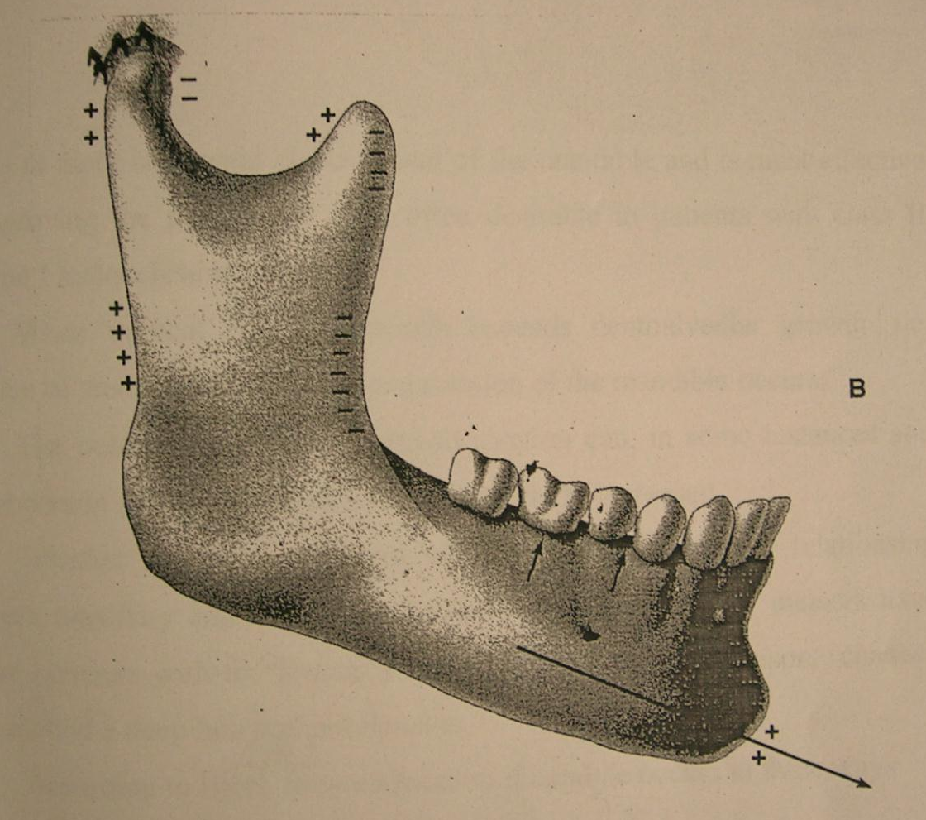
3) Condylar growth pattern
In normal individuals, the growth at the head of the condyle occurs in an upward and backward direction. Mandibular growth is expressed as a downward and forward displacement
Bishara SE. Textbook of Orthodontics, W.B. Saunders, 2002

Slide 29
Patients with deep bite have an upward and forward growth of the condyle with reduced anterior face height.
Growth in this direction often results in more horizontal displacement of the mandible and is most effective in improving the position of chin, often desirable in patients with class II division I malocclusion.
When vertical condylar growth exceeds dentoalveolar growth.
i.e. eruption of teeth in the jaws; forward rotation of the mandible occurs

Slide 30
II. ACQUIRED FACTORS
The deep overbite may be due to -
Muscular habits
Changes in tooth position
3) The loss of posterior supporting teeth
4) Lateral tongue thrust habit.
Geiger A, Hirshfeld L. Minor tooth movements in general practice 3rd Ed. Mosby Co.

Slide 31
1) Muscular habits
Severe clenching or grinding habits or hypertonicity of the masticatory muscles may cause depression of the posterior teeth. Excessive tooth wear also may result in a loss of vertical height.

Slide 32
2) Changes in tooth position
Premature loss of deciduous molar teeth may permit mesial drifting of the first permanent molars with subsequent impactions or crowding of bicuspid teeth. This anterior displacement of the posterior support of the dentition may lead to the development of an excessive overbite.

Slide 33
3) The loss of posterior supporting teeth
In the adult dentition, extraction of molar or bicuspid teeth without replacement will permit adjacent teeth to drift toward the space. Such migration often causes abnormal axial inclinations and a deepening of the bite. This frequently directs excessive trauma against maxillary incisor teeth.

Slide 34
4) Lateral tongue thrust habit
A lateral tongue thrust or postural position frequently can produce an acquired deep overbite. This type of dysfunction produces an infraocclusion of posterior teeth.
In these cases the free way space is usually large.

Slide 35
FACIAL CHARACTERISTICS OF DEEP BITE
Brachycephalic face or europroscopic face.
Hypodivergent growth pattern
Skeletal Class II tendency.
Convex profile.
Short vertical dimension and lower third of the face.
Hypodivergent growth tendency.
Retrognathic Mandible .
Reduced Gonial angle
Square gonial angle
Prominent chin
Reduced mandibular plane angle

Slide 36
Retrognathic Mandible .
Reduced Gonial angle
Square gonial angle
Prominent chin
Reduced mandibular plane angle

Slide 37
INTRA ORAL FEATURES
The maxillary dental arch is broad, with often a maxillary bucccal cross-bite.
May involve a group of teeth or whole dentition.
Diminished occlusal plane
The patient may exhibit gummy smile if there is clockwise rotation of maxilla .
When the problem is in the anterior maxillary region, the patients often show excessive gingival tissue during smiling or event while speaking even when the upper lip is of adequate length. GUMMY SMILE
Notes:
PASTE A PIC OF GUMMY SMILE
HEADINGS Callibary headings with italics with headuing in center
And
Matter in slide – gabriola

Slide 38
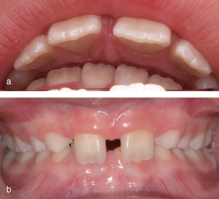
INTRA ORAL FEATURES
The presence of deep bite may cause palatal grooving by the indentations caused by lower anteriors.
The dentition exhibits a tendency to small teeth prone to abrasion and a high increased percentage of congenitally missing teeth.

Slide 40
Unfavorable Sequelae of deep bite
Deep bite affects the facial esthetics
Impairs the dental health of the individual
Excessive overbite where the lower incisors hit the lingual of maillary incisors opr gingival tissues results in PDL destruction.
There will be anterior migratioj of maxillary anterior teeth.
Wear of mandibular incisors
Spacing in maxillary anterior region
Leads to problem in TMJ.

Slide 41
CONCLUSION
Deep overbite is common form of malocclusion that may be addressed in many ways, including posterior extrusion, anterior intrusion and combinations.
The specific approach to bite opening should be selected based on each patient’s needs.
Soft Tissue, Crown-Gingival Relations, Occlusal plane, and skeletofacial concerns are among the special considerations for treatment planning for deep overbite correction.

Slide 42
REFERENCES
Textbook of Orthodontics – Gurkeerat Singh, Jaypee Brothers; 2nd Edition
Orthodontics – The Art and Science, S.I Bhalajhi, AryaMedi Publishing; 7th Edition
Textbook of Orthodontics – Sridhar Premkumar, Elsevier; 1st Edition
Orthodontics: Diagnosis and Management of Malocclusion and Dentofacial Deformities – O.P Kharbanda, Elsevier; 1st Edition

Slide 43
Question & Answer Session

